Slide 1
FSO Story Board
A CIL FSO Demo
Toshihiro Imai, Solutions Architect, timai@cisco.com
Cody Hartsook, Software Engineer, chartsoo@cisco.com
Leandro Schwab Dias Carneiro, Software Engineer, lschwabd@cisco.com
Brianna Gilchrist, Software Engineer, brgilchr@cisco.com
Keshav Kumar, Software Engineering Technical Leader, keskuma2@cisco.com
Felix Kaechele, Engineering Technical Leader, fkaechel@cisco.com
Jyoti Chaturvedi, Solutions Architect, jychatur@cisco.com
24 Feb 2023

Slide 2
About this Document
This deck is intended for internal Cisco teams only;
it is designed to help anyone understand the FSO demo story and how to present it

Slide 3
Introduction

Slide 4



Jack
Leadership
Samantha
Manager, IT Operations
Michael
Customer / End User
Gain a holistic view of IT operations and performance to support business strategy
Drive innovation and digital transformation across the organization, technology investments with business strategy and goals
Struggling with disparate teams and tools, making it difficult to optimize the tech landscape
Needs visibility into the end-to-end performance of their systems and applications
Ensuring systems are meeting Service Level Objectives and avoiding downtime
Struggling with siloed teams and fragmented tools, making it hard to correlate data and troubleshoot effectively
Needs the applications he uses to be responsive and reliable
Appreciates information as to where any issues may originate (e.g., local internet issue vs. platform outage)
Finds engaging support ineffective as the time from reporting his specific issue to an overall solution is too long

Slide 5



Sarah
Application Developer
Emily
DevOps Engineer / SRE, Support
David
IT Auditor, Corporate Compliance
Wants to better understand how applications perform in production
Save time identifying root causes of issues to maintain high customer satisfaction levels
Lack of context due to fragmented logging and performance reporting on a component basis
Wants to spend less time hunting down errors and performance issues and get to fixing them as quickly as possible
Needs to balance scaling the application between performance and cost efficiency
Struggling with too much noise, unspecific information and false positives from existing monitoring solutions
Wants to ensure compliance, security and integrity of applications
Needs to be able to identify risks and vulnerabilities immediately
Finds it hard to deduct compliance related metrics from mostly engineering focused logging and reporting

Slide 6
Scenario: Self Service and extendable Demo application
Story Walkthrough:
Emily and Sarah attend Cisco Live EMEA and want to try out FSO and Cloud Native tools to apply on top of their application and now looking for references.
They also want to compare the FSO Platform vs Other Competitor tools vs Open source.
They want to demo the application to be extendable. They wish to replace a microservice, change to a different database vendor, or change a caching system as per their choice or business need. They also want to observe FSO tools.
Behind the scenes:
The CIL team is developing a self-serviceable demo.
The CIL team will be writing helm and other accessible executable artifacts so anyone can start to see the impactful outcome within hours.
Cody/Keshav to update
Visuals:
Architecture Diagram

Slide 7
Scenario : OTel with FSO
Cody/Keshav to update
OpenTelemetry provides a standardized, vendor-neutral way to collect telemetry data from any distributed and monolith system component, regardless of language or technology stack. It is designed to work seamlessly with cloud-native technologies like Kubernetes, Istio, and serverless platforms.
Story Walkthrough:
Emily hears a lot about Otel from her SRE community, and she builds a POC application using Otel to generate telemetry (MELT) data and show it to Samantha.
Samantha gets excited by seeing Otel's massive potential and wants to try OTEL for one department application with AppD and TEs.
Samantha looks at traces, span, logs and metrices at custom AppD Dashboard
Behind the scenes:
AppD Saas &Cloud and TE is ingesting Otel Data.
FSO Platform is under development which can ingest data from various source and format and many more features support around Otel Standards
Visuals:
AppD screenshot
Scenario 1 The company already have Otel and want to see how to integrate with appd and what value of using it
Scenario 2 Using Otel to extend and empower features with in appd
Several softwares already integrate with Otel
Appd can concentrate multiple sources of information and correlate these data with.
Focus on the AppD aspect
Allow users to tap into existing Otel Integrations, especially when AppD integration is not available
Leverage FSO Platform for information beyond AppD

Slide 8
Overarching storyline
OTel
Fault Detection
Cost Optimization
What the Figma Demo needs to show
We can integrate apps using OTel and AppD Agents
We can monitor our applications and inject and detect faults
We can look at our overall usage of our nodes and the impact it has on our cost (overprovisioning, etc.)

Slide 9
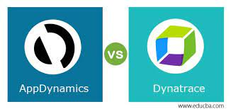

Scenario : Cross Tools Integration
Jyoti to update
Samantha the IT Manager from ABC Bank has Non-Cisco products like DynaTrace, DataDog etc for their application observability.
She is happy with current observability tools. But is missing some of the key metrices.
E2E Network visibility is also a major concern for her.
During one of the Cisco Events Samantha got a chance to view AppD and TE demos on the Cisco booth.
She was excited to see the new feature of Business Risk Observability in AppD.
Now she wants to explore more about it and see how it can be integrated with current observability landscape
Some of the application services are having bottleneck and her team is having trouble in find out the issue. And would be interested in exploring TE as well.

Slide 10

Scenario : Cross Tools Integration
Jyoti to update
Story Walkthrough:
Sales team reached out to CIL team for innovative solution on this scenario.
CIL team after understanding the requirements build a quick demo for ABC Bank
Behind the scenes:
Telemetry will be ingested to FSO platform to display Business Risk Observability on AppD
Telemetry from DyanaTrace/DataDog OTel agents will be ingested to FSO platform.
TE agent endpoints will be configured to monitor the ABC Bank network
Visuals:
TBD - AppD screenshot/dashboard
Transaction view to monitor communication between the networks

Slide 11
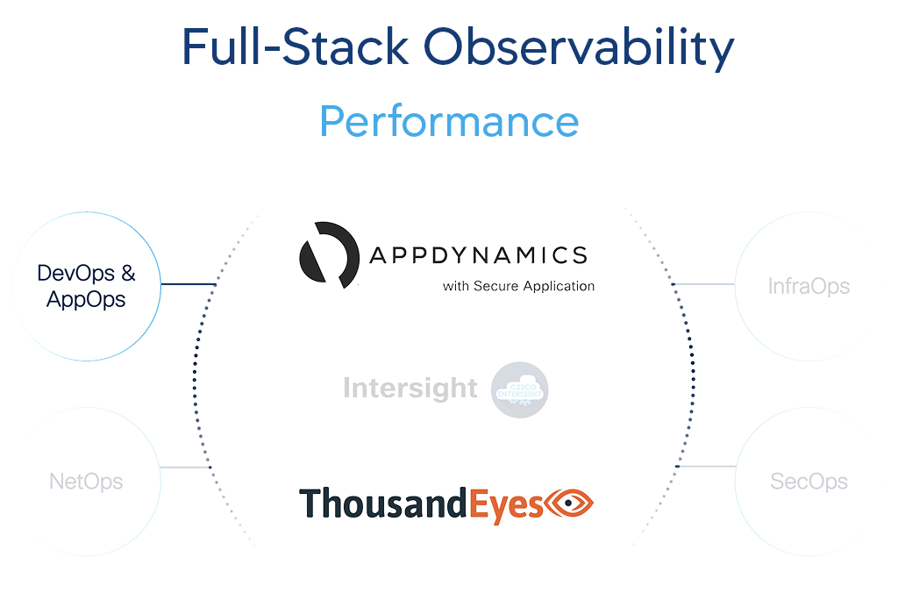
Scenario : Unified Dashboard
Jyoti to update
Yes Bank from India has brought the entire Cisco’s FSO suite (AppD, TE and IWO)
Jack the CIO of Yes Bank finds difficult to view all the metrics as all these products have different dashboards.
Jack has to navigate to 3 different dashboard to get an overall picture of his IT infrastructure.
Story Walkthrough:
Jack opens one single dashboard where he can view all the relevant metrices from all three products (AppD, IWO, TE)
He can view APM metrices and moving until the network layer visibility
Single pane of glass to view his entire IT infra
Behind the scenes:
AppD CSaas will be integrated with TE end use monitoring.
AppD, TE, IWO will be update a time series DB which will be used for displaying Graphana dashboards.
Visuals:
WIP – Unified FSO Dashboard screenshot

Slide 12
Scenario : AppD Cloud with Grafana Dashboard
Keshav to update
Jack and Samantha took a survey with their IT employees about which Observability Dashboard is the excellent suite
for the organization and found out that Grafana is most popular among Emily’s and Sarah’s colleagues.
Story Walkthrough:
Jack observes that they have monolith and microservices-based applications and
He knows AppD is the best APM tool. Still, their IT professional has limited knowledge about AppD, so he discussed with Samantha and wants to try Appd Agent to generate telemetry from the application and use Grafana as a dashboard tool because of the following reasons:
1. Customizability: Grafana is highly customizable and allows users to create visualizations and dashboards that best fit their specific needs and use cases.
2. Integration with other data sources: Grafana can integrate with many data sources, not just AppDynamics Cloud. This allows users to combine and analyze data from multiple sources in a dashboard.
3. Familiarity: Some users may already be familiar with Grafana and prefer to use it as their primary dashboard for all their monitoring data, including AppDynamics Cloud data.
Behind the scenes:
Emily experiments AppD agent in an application and installs the Grafana plugin to fetch data from the AppD cloud to build a grafana dashboard for monitoring and analyzing application and infrastructure performance data.
Visuals:
Grafana screenshot

Slide 13
Scenario: Data Sovereignty
Imai San to update
Story Walkthrough:
Jack and David think data sovereignty becomes more complex in the cloud and is an issue in risk management and governance processes so that their organization using hybrid-cloud strategies must address data sovereignty analysis holistically.
Jack and David consider FSO to investigate where the data is stored, what laws apply to it, and whether storing data in a certain location is beneficial or harmful to their business because of limitations on data transmission outside the original country, privacy laws that restrict the disclosure of personal data to third parties and so on….
David uses FSO to check if the production workload data and its back-ups are stored in geolocation and under the jurisdiction of country’s laws.
Behind the scenes:
Using TE and FSO analyze multiple points of data with metrics around compliance (e.g. data sovereignty, business constraints, licensing….).
Visuals: - Not Applicable
AppD screenshot
Notes:
At any point of time IT Auditor or Country Head want to see Where data is stored
IT Auditor login to TE to see data storage network call and they can verify actual ip address of server and location where data is stored
People can extract a report and submit it to compliance purpose

Slide 14
Scenario: Software Composition Analysis (SCA)/ SBOM / Open Source dependency Posture
Imai San to update
Story Walkthrough:
Samantha and Sarah think SBOM to improve visibility, transparency, security and integrity of proprietary and open-source code in software supply chains because of White House EO 14028, U.S. which mandates organizations that sell to the Federal Government improve their software supply chain security.
Samantha and Sarah consider FSO for real-time visibility and inventory of complex software components in their service platform and enabling organizations to make better-informed decisions around managing software vulnerability risks and policy violations.
Sarah as software producer uses FSO for making SBOMs to assist in building and maintaining software packages, understand what vulnerabilities are reported and take appropriate actions to secure digital operations.
Behind the scenes:
Using Panoptica and FSO to provide seamless view including SBOM analysis which could yield instant inventory of application softwares.
Visuals:
AppD screenshot
Notes:
Leadership want to see a summary of list of Open source library and tools used to build application/ platform
Using Panoptica we can share dependency graph, SBOM, Vulnerabilities present in application.
Panapotica can share report and current state of remediation for vurnabilities, In Future it will be utilizing Talo's Intelligence

Slide 15
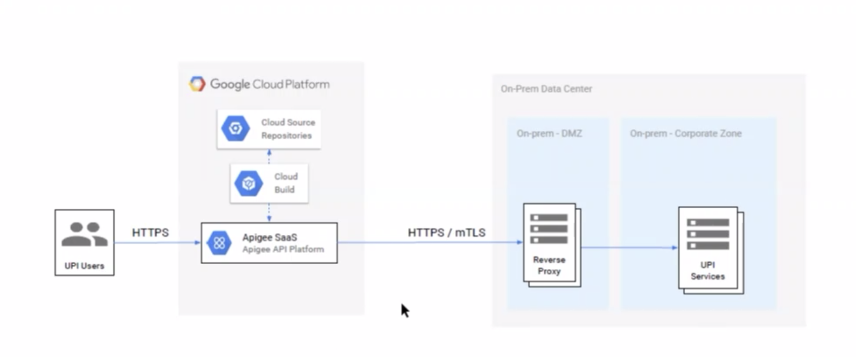
Scenario: API Performance Monitoring
Jyoti to update
Story Walkthrough:
Around 6k to 7k Bank merchants use Bank API services in the form of internet banking/mobile banking, etc. Some merchants complaints about slowness but not sure where and why the slowness is there. Bank with the back end team confirms there are no issue in their RTGS/NEFT/etc API services.
Bank use Apegee SaaS API service between Merchants and Bank (diagram below). Bank team would like to monitor the Inbound/outbound API calls with step by step transaction details and understand where the slowness is happening.
Bank team finds it difficult to isolate the problem. Basically they would like to monitor each transactions of API calls and network behaviour while API calls are happening.
Behind the scenes:
Visuals:
AppD screenshot

Slide 16
Scenario: Cost Optimization
Brianna to update
Due to current economic constraints, executives have been putting pressure on directors and managers to re-evaluate and optimize their spend for the current and upcoming quarter by ensuring operational excellence. This worries Tom, an IT director, as he wants to ensure that his teams and projects won't get impacted.
Tom logs into an FSO dashboard, that is integrated with AppD, TE, and IWO insights and visibility. He then notices that IWO is suggesting an certain optimization that could save one of his teams $$$ with a few adjustments.
Tom contacts the team, and lets the team know his recommendation, as well as where it came from. The task is now assigned to Will, an IT support engineer.
Will takes Tom's recommendation, and begins to do some adjusting. As he is adjusting, he is also keeping a close eye on TE & AppD to ensure that this change is in fact effective.
Will takes Tom's recommendation, and begins to do some adjusting. As he is adjusting, he is also keeping a close eye on TE & AppD to ensure that this change is in fact effective.
Tom can now see the positive cost changes reflected in IWO, and can rest assured that this project will continue. He saves his report, and prepares to represent his cost-efficient teams to the executives.
Story Walkthrough:
Behind the scenes:
Visuals:
AppD screenshot

Slide 17
Scenario: Service Mesh manager(Calisti) Use Case: Fault Injection
Leonardo to update
Story Walkthrough:
Samantha and Emily has been struggling with identifying potential performance issues and ensuring the reliability of the company's applications. She wanted to simulate different types of faults, such as delayed or failed responses, and monitor how your application responds under these conditions.
Using Calisti Mesh Management tool, they log in the dashboard and verify that there is no alert on the overview dashboard.
They will then go to the topology view where they can view the application workflow. There they can see the number of requests per second between services
Then they will select and microservice, go to traffic management tab and create a new rule with the parameter for the fault injection they want to test.
Next, on the overview and in a few minutes some alerts will appear. In the topology view, you can see how this failure affects other services.
To add:
Use other tools (appd, thousandeyes) to monitor the application
Behind the scenes:
Visuals:
Calisti Walktrhough screenshot
Possible Use cases:​
Traffic Management​
Canary deployment​
Circuit Breaking​
Enforcing MTLS

Slide 18
Leo to update
Scenario 1: App/Platform Stats
Month-end/Quarter is approaching and IT SVP needs to check metrics. With the current state of the economy, the SVP is concerned with operating costs, and hopes to optimize.
IT SVP logs into dashboard to view FSO metrics
Based on these metrics, IT SVP can make more informed decisions about department spending.
Story Walkthrough:
Behind the scenes:
Visuals:
AppD screenshot

Slide 19
Backup Slides

Slide 20
Scenario: Triaging Use case
Keshav/Felix to update
Story Walkthrough:
Behind the scenes:
Visuals:
AppD screenshot

Slide 21
Scenario: FSO Tools with Hybrid cloud

